Slide 1
Chapter 2
Database System Concepts and Architecture

Slide 2
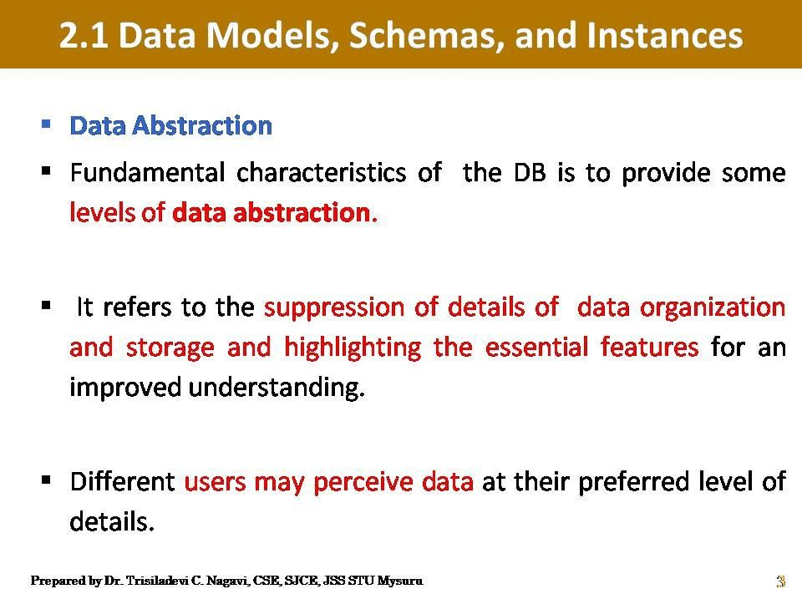
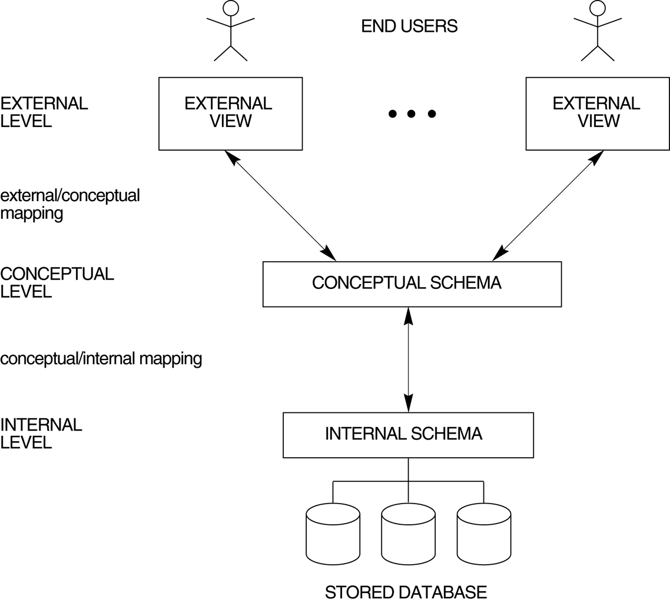
Three-Schema Architecture
Slide 2-<number>

Slide 3
Data Models
Data Model: A set of concepts to describe the structure of a database, and certain constraints that the database should obey.
Data Model Operations: Operations for specifying database retrievals and updates by referring to the concepts of the data model. Operations on the data model may include basic operations and user-defined operations.
Slide 2-<number>

Slide 4
Categories of data models
High Level or Conceptual Data Models: (high-level, semantic) data models: Provide concepts that are close to the way many users perceive data. (Also called entity-based or object-based data models.)
Low Level or Physical Data Models: (low-level, internal) data models: Provide concepts that describe details of how data is stored in the computer.
Slide 2-<number>

Slide 5
Categories of data models
Representational or Implementational Data Models: Provide concepts that fall between the above two, balancing user views with some computer storage details.
Self Describing Data Models:
Data Storage contains both the description of data and data values together.
In traditional DBMS both are separated
Ex: XML, NoSQL Systems (Big data applications using Mango DB)
Slide 2-<number>

Slide 6
The Entity Relationship Model
The ER model is the most commonly used conceptual model
In this model, the real world consists of a collection of basic objects called entities and the relationships among these objects
An entity is an object that is distinguishable from other objects by a specific set of attributes
An entity set is the set of all entities of the same type
A relationship is an association among entities
The set of all relationships of the same type is a relationship set
One nice thing about this model is that you can represent the logical structure of a DB graphically, using an ER diagram.
Slide 2-<number>

Slide 7
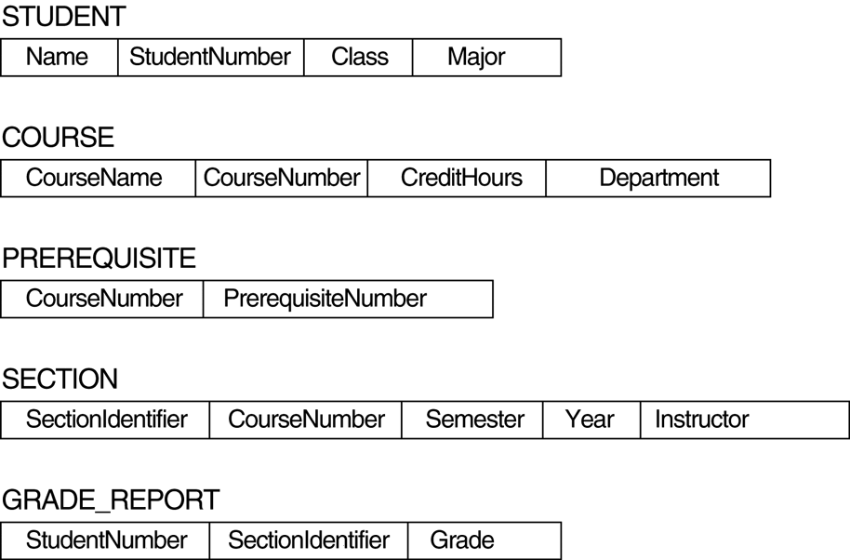
FIGURE 2.1
Schema diagram for the database in Figure 1.2.
Slide 2-<number>

Slide 8
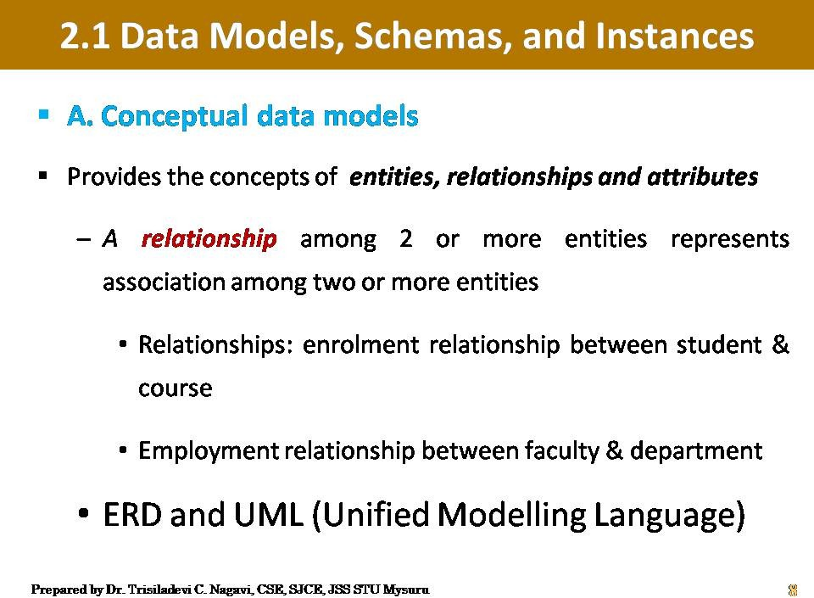

Slide 9
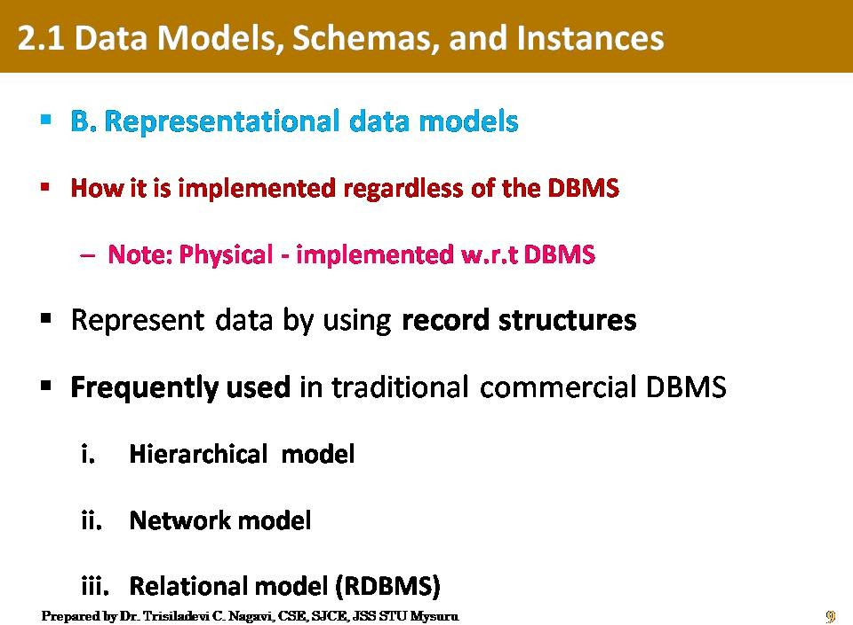

Slide 10
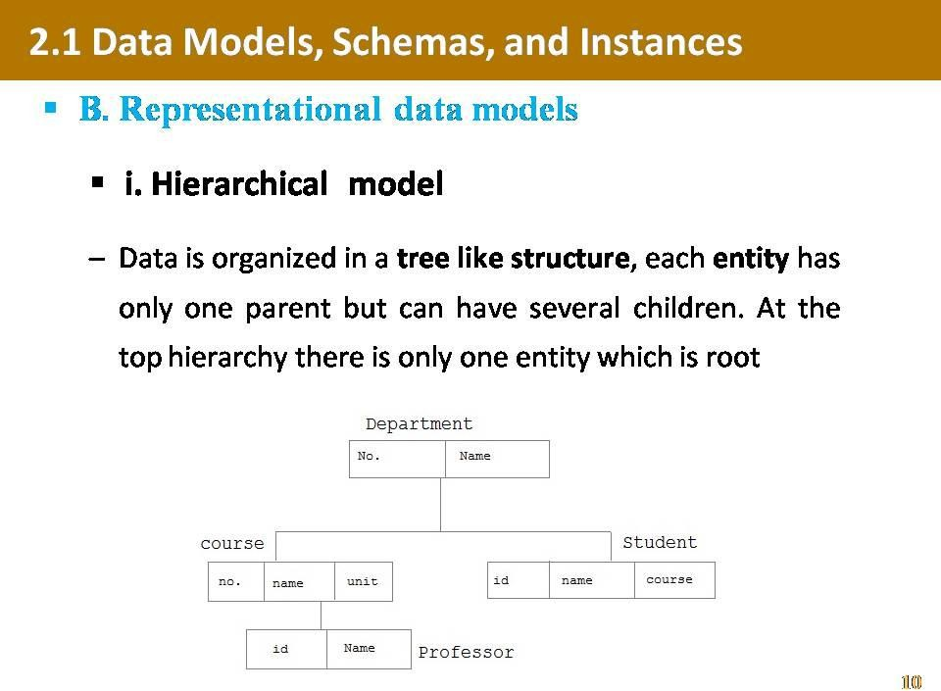

Slide 11
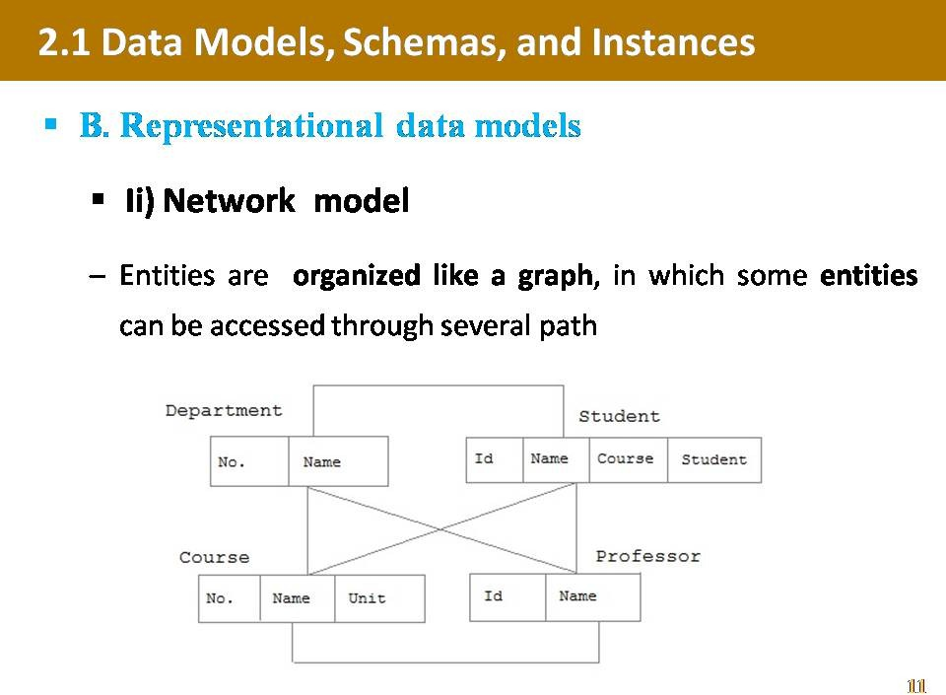

Slide 12
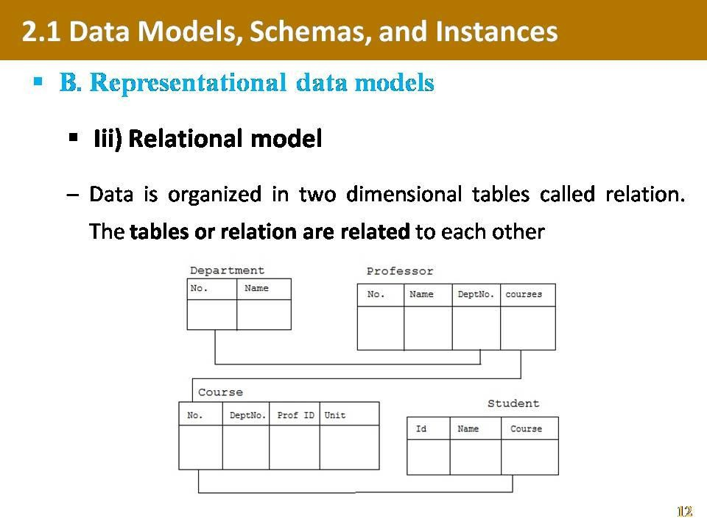

Slide 13
Definitions
Database Schema: The description of a database. Includes descriptions of the database structure and the constraints that should hold on the database.
Schema Diagram: A diagrammatic display of (some aspects of) a database schema.
Schema Construct: A component of the schema or an object within the schema, e.g., STUDENT, COURSE.
Database Instance: The actual data stored in a database at a particular moment in time. Also called database state (or occurrence).
Slide 2-<number>

Slide 14
Database Schema Vs. Database State
Database State: Refers to the content of a database at a moment in time.
Initial Database State: Refers to the database when it is loaded
Valid State: A state that satisfies the structure and constraints of the database.
Distinction
  The database schema changes very infrequently. The database state changes every time the database is updated.
  Schema is also called intension, whereas state is called extension.
Slide 2-<number>

Slide 15
Three-Schema Architecture
Proposed to support DBMS characteristics of:
  Program-data independence.
  Support of multiple views of the data.
Slide 2-<number>

Slide 16
Three-Schema Architecture
Slide 2-<number>

Slide 17
Three-Schema Architecture
Defines DBMS schemas at three levels:
  Physical or Internal schema at the internal level to describe physical storage structures and access paths. Typically uses a physical data model.
  Conceptual schema at the conceptual level to describe the structure and constraints for the whole database for a community of users. Uses a conceptual or an implementation data model.
  External schemas at the external level to describe the various user views. Usually uses the same data model as the conceptual level.
Slide 2-<number>

Slide 18
Data Independence
When a schema at a lower level is changed, only the mappings between this schema and higher-level schemas need to be changed in a DBMS that fully supports data independence. The higher-level schemas themselves are unchanged. Hence, the application programs need not be changed since they refer to the external schemas.
Slide 2-<number>

Slide 19
Data Independence
Logical Data Independence: The capacity to change the conceptual schema without having to change the external schemas and their application programs.
Physical Data Independence: The capacity to change the internal schema without having to change the conceptual schema.
Slide 2-<number>

Slide 20
DBMS Languages
Data Definition Language (DDL): Used by the DBA and database designers to specify the conceptual schema of a database. In many DBMSs, the DDL is also used to define internal and external schemas (views). In some DBMSs, separate storage definition language (SDL) and view definition language (VDL) are used to define internal and external schemas.
Slide 2-<number>

Slide 21
DBMS Languages
Data Manipulation Language (DML): Used to specify database retrievals and updates.
  DML commands (data sublanguage) can be embedded in a general-purpose programming language (host language), such as COBOL, C or an Assembly Language.
  Alternatively, stand-alone DML commands can be applied directly (query language).
Slide 2-<number>

Slide 22
DBMS Languages
High Level or Non-procedural Languages: e.g., SQL, are set-oriented and specify what data to retrieve than how to retrieve. Also called declarative languages.
Low Level or Procedural Languages: record-at-a-time; they specify how to retrieve data and include constructs such as looping.
Slide 2-<number>

Slide 23
DBMS Interfaces
  Menu-based Interfaces for Web Clients or Browsing.
  Apps for Mobile Devices.
  Forms-based interfaces.
  Graphical User Interfaces (Point and Click, Drag and Drop etc.,).
  Natural Language Interfaces (requests in written English).
  Key word-based Database Search.
  Speech Input and Output.
  Interfaces for parametric users (e.g., bank tellers).
  Interfaces for the DBA.
  Combinations of the above
Slide 2-<number>

Slide 24
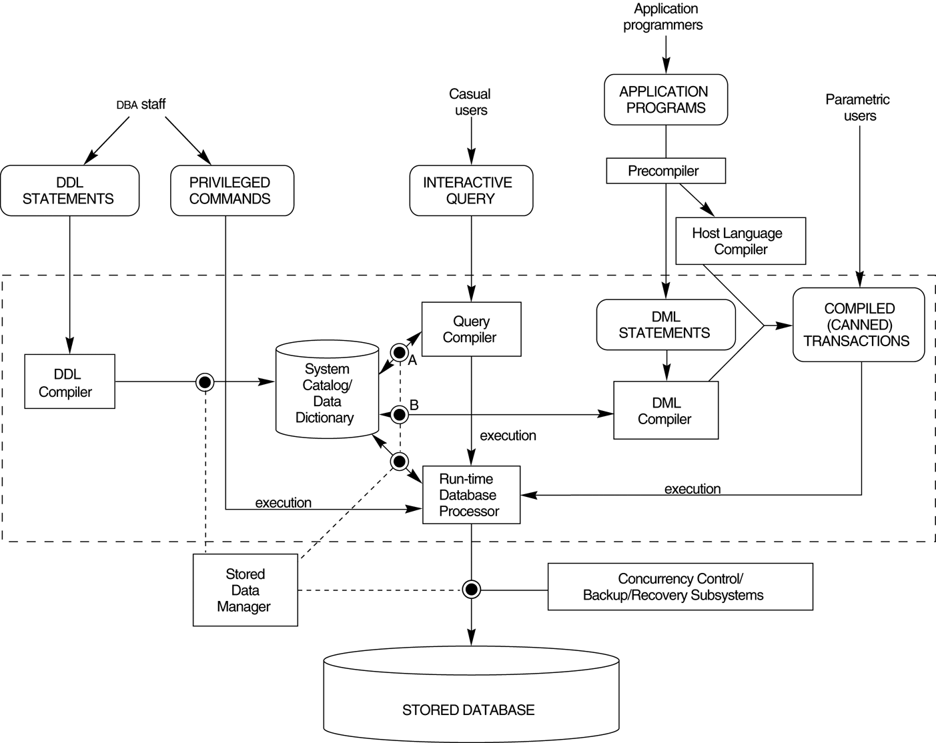
The Database System Environment: DBMS Component Modules
Slide 2-<number>

Slide 25
Database System Utilities
  DBMSs have database utilities that help the DBA to manage the database system:
  Loading data stored in files into a database. Includes data conversion tools.
  Backing up the database periodically on tape.
  Database Storage Reorganization: Reorganizing database file structures.
  Report generation utilities.
  Performance monitoring utilities.
  Other functions, such as sorting, user monitoring, data compression, etc.
Slide 2-<number>

Slide 26
Thank you..

